Slide 1

Digital Portfolio
STUDENT NAME: BOOPALAPRIYAN. A
REGISTER NO AND NMID: 2F13FCC4064031B814B41B84CF83B7BB
DEPARTMENT: BSC INFORMATION TECHNOLOGY
COLLEGE: COLLEGE/ UNIVERSITY: KAAMADHENU ARTS AND SCIENCE COLLEGE/ BHARATHIAR UNIVERSITY
1
Notes:
1

Slide 2

PROJECT TITLE
Interactive Student Portfolio Website – Boopala Priyan
2

Slide 3



AGENDA
Problem Statement
Project Overview
End Users
Tools and Technologies
Portfolio design and Layout
Features and Functionality
Results and Screenshots
Conclusion
Github Link
3/21/2024 Annual Review
3

Slide 4

PROBLEM STATEMENT
Many students and early professionals struggle to showcase their skills, projects, and achievements in a structured and appealing way. Traditional resumes fail to highlight creativity and interactivity. The problem is the lack of a modern, accessible, and engaging portfolio that effectively represents an individual’s technical and personal profile.
‹#›

Slide 5

PROJECT OVERVIEW
This project is a personal portfolio website built by Boopala Priyan using HTML, CSS, and JavaScript. The portfolio provides a digital presence to showcase skills, projects, and contact information in an interactive and visually appealing format. The goal is to demonstrate both technical expertise and creative design while providing recruiters, peers, and collaborators with easy access to relevant details.
5

Slide 6

WHO ARE THE END USERS?
Recruiters & Employers – to quickly assess skills and projects.
Peers & Collaborators – to connect for teamwork or learning.
Educators & Mentors – to evaluate technical growth and capabilities.
General Audience – anyone interested in Boopala Priyan’s work and achievements.
6

Slide 7

TOOLS AND TECHNIQUES
Frontend: HTML5, CSS3, JavaScript
Styling & Layout: CSS Grid, Flexbox, Linear Gradient backgrounds
Interactivity: JavaScript (Typing effect, Scroll animations)
Design Elements: Custom color palette, text-shadow, hover effects
Version Control: Git & GitHub for hosting and collaboration
7

Slide 8
POTFOLIO DESIGN AND LAYOUT
Header: Typing animation introducing the name Boopala Priyan and navigation menu.
About Section: Personal introduction with background and interests.
Skills Section: Grid-based skill badges showcasing technical expertise.
Projects Section: Interactive project cards with hover effects describing past works.
Contact Section: Email, LinkedIn, and GitHub links for easy communication.
Footer: Minimalist design with copyright.
The layout is clean, responsive, and engaging with animated transitions.
8

Slide 9
FEATURES AND FUNCTIONALITY
Typing animation for an engaging header.
Smooth scroll-reveal effect for sections.
Interactive project cards with hover effects.
Responsive design for mobile, tablet, and desktop.
Highlighted links for better readability.
Easy navigation between sections.

Slide 10
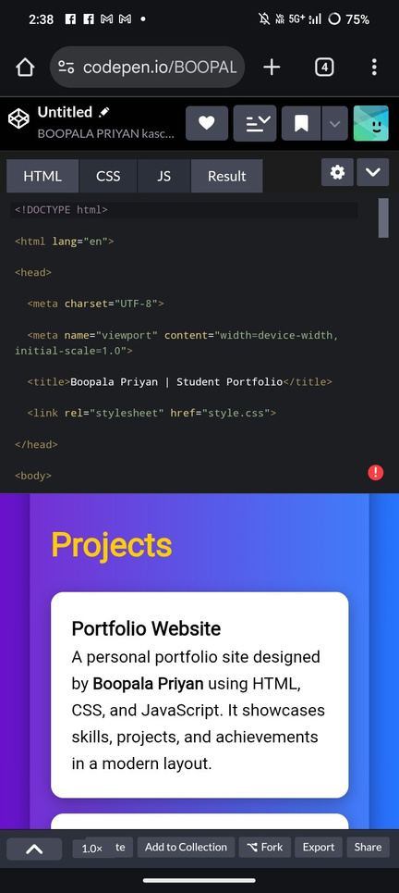
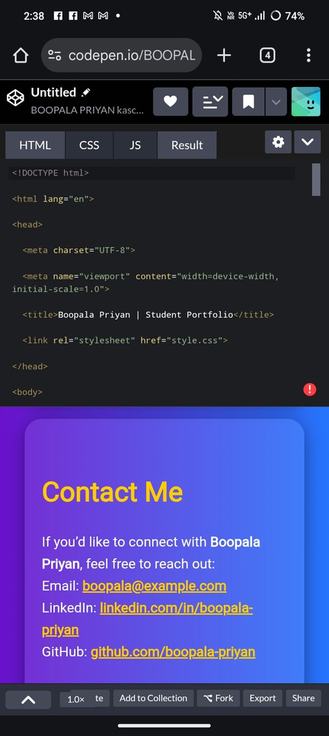
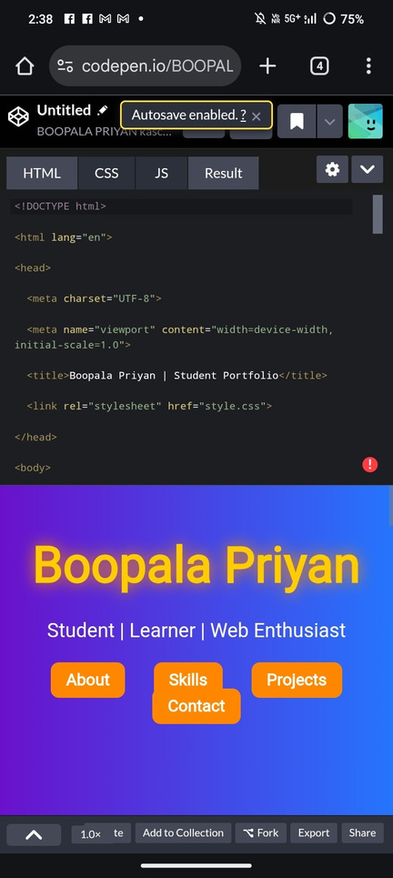
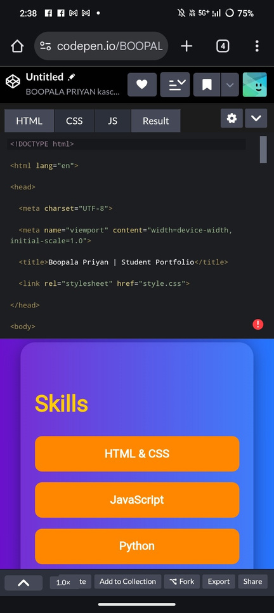

RESULTS AND SCREENSHOTS
3/21/2024 Annual Review
10

Slide 11
CONCLUSION
The portfolio website successfully addresses the need for a modern digital resume by combining functionality, design, and interactivity. It highlights technical skills, projects, and contact details in a visually appealing manner. This project also demonstrates proficiency in web technologies and serves as a foundation for future enhancements, such as adding blogs, certifications, or live project demos.
11

